Slide 1
Comparing model with simulation

Slide 2
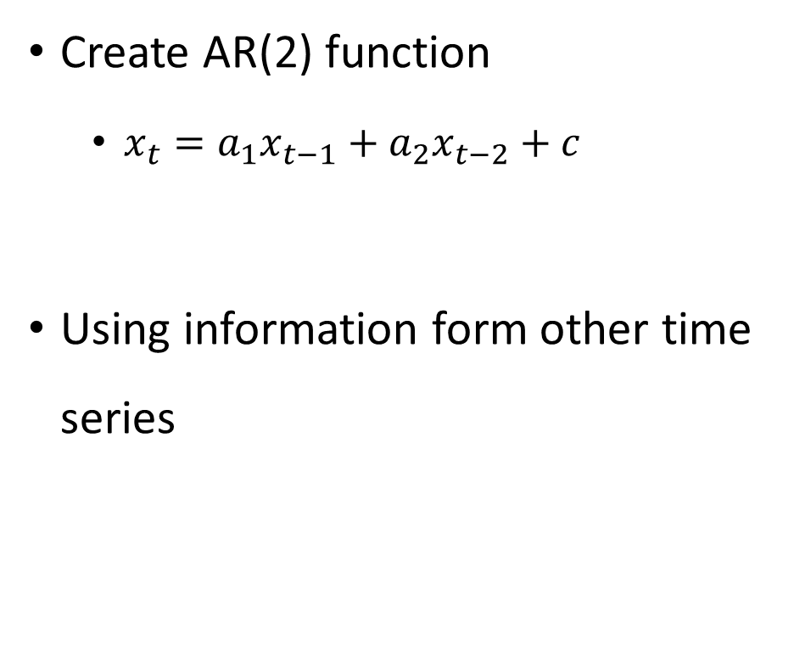
OLS regularization
Create AR(2) function
$x_{t}=a_{1}x_{t−1}+a_{2}x_{t−2}+c$
Using information form other time series
O(x):
O(y):

Slide 3
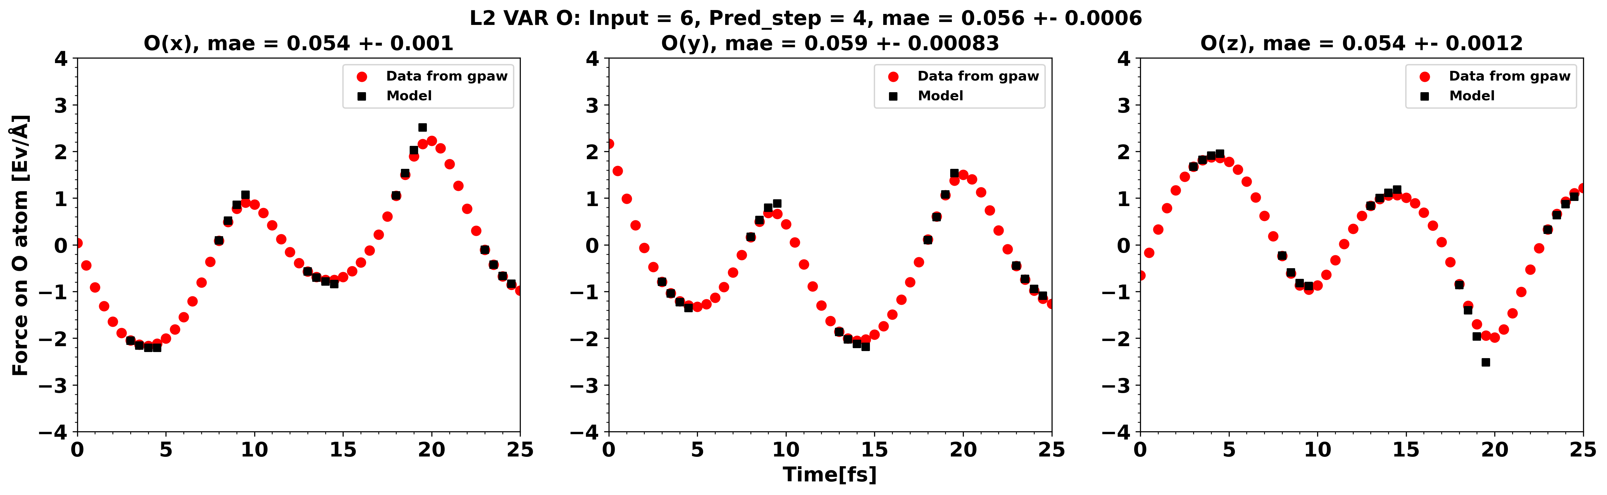
OLS VAR regularization

Slide 4
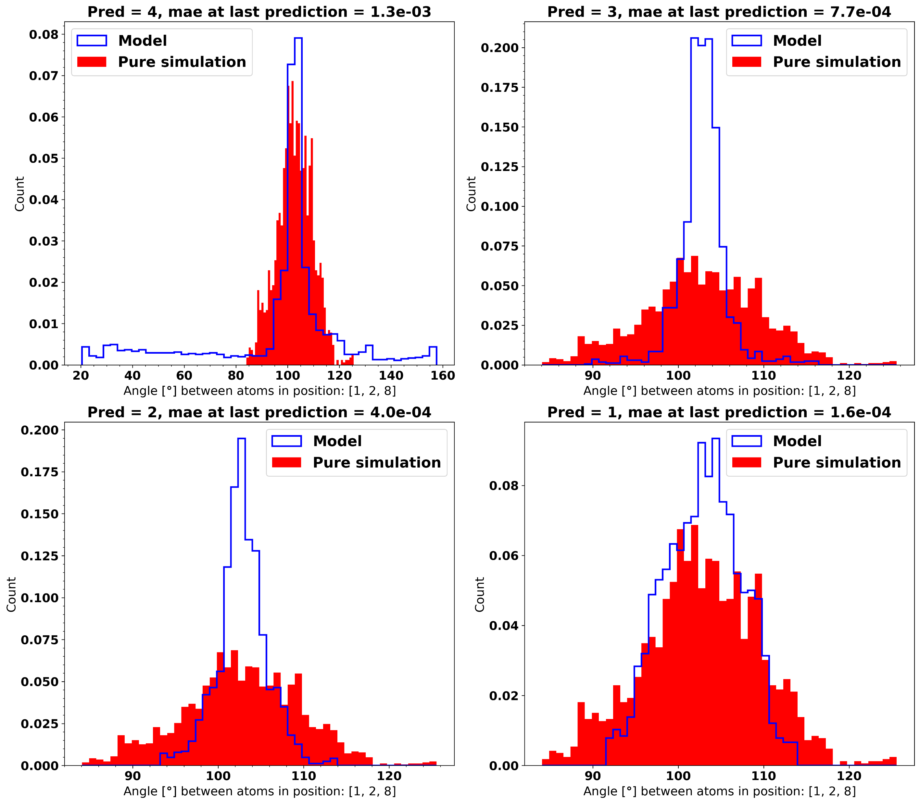
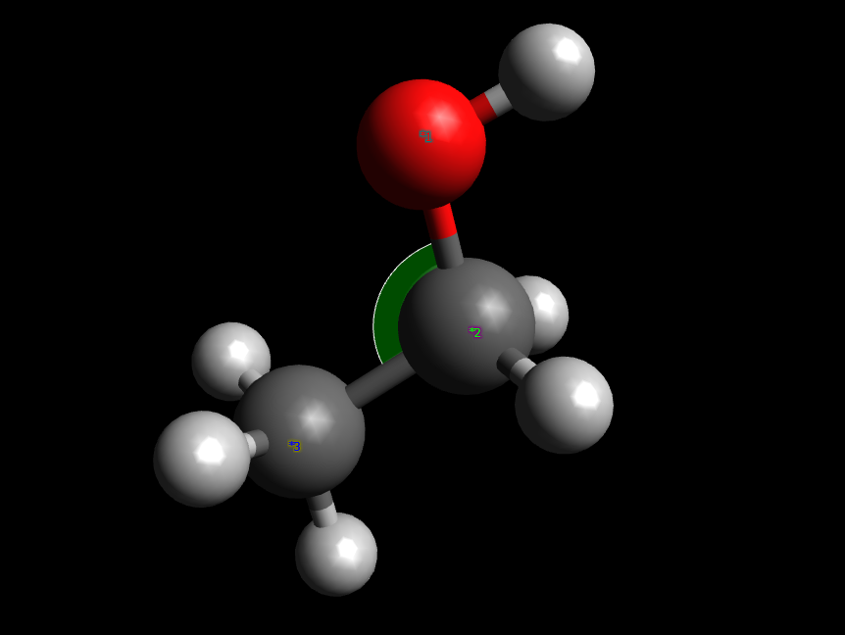
Distribution of angle

Slide 5
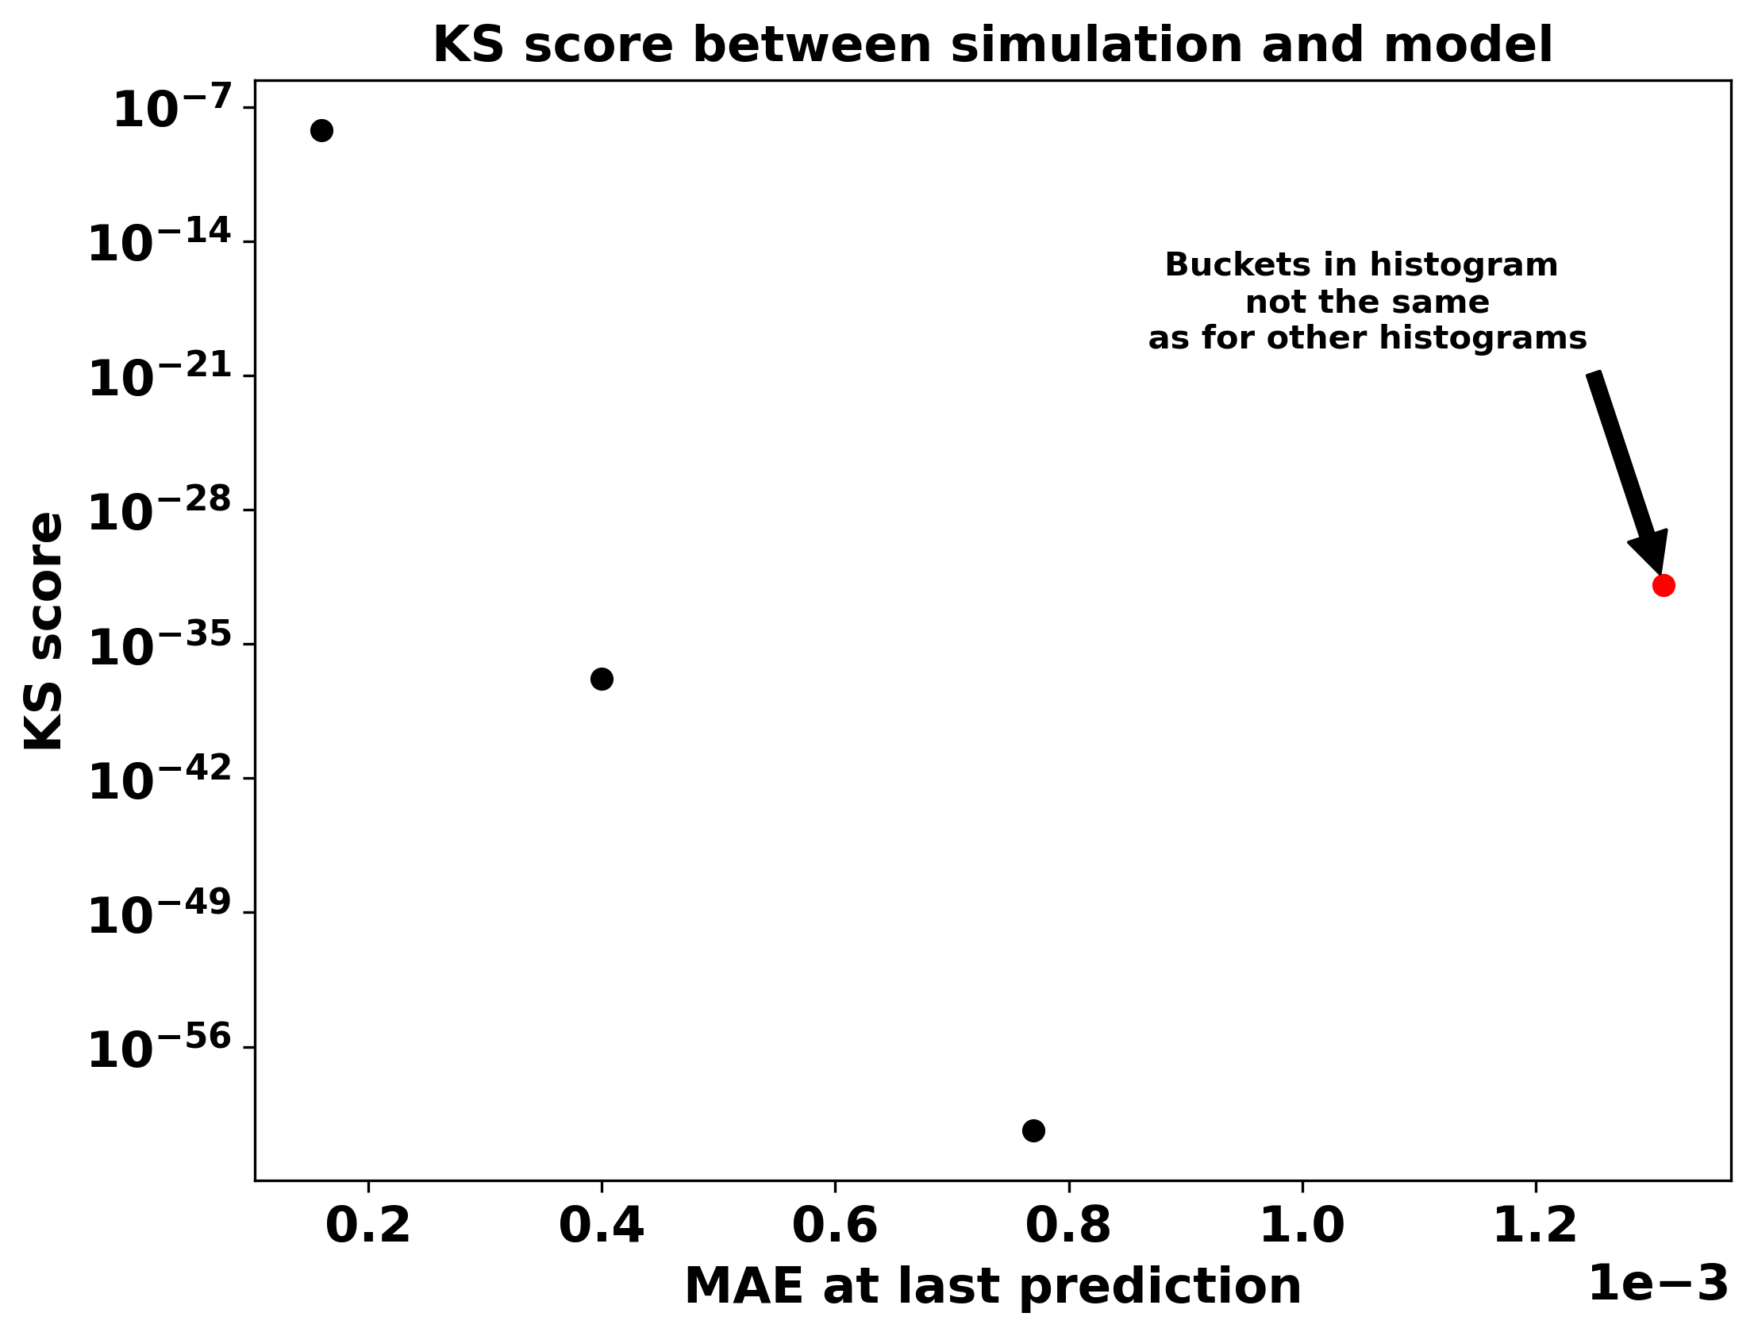
KS score of angle comparison

Slide 6
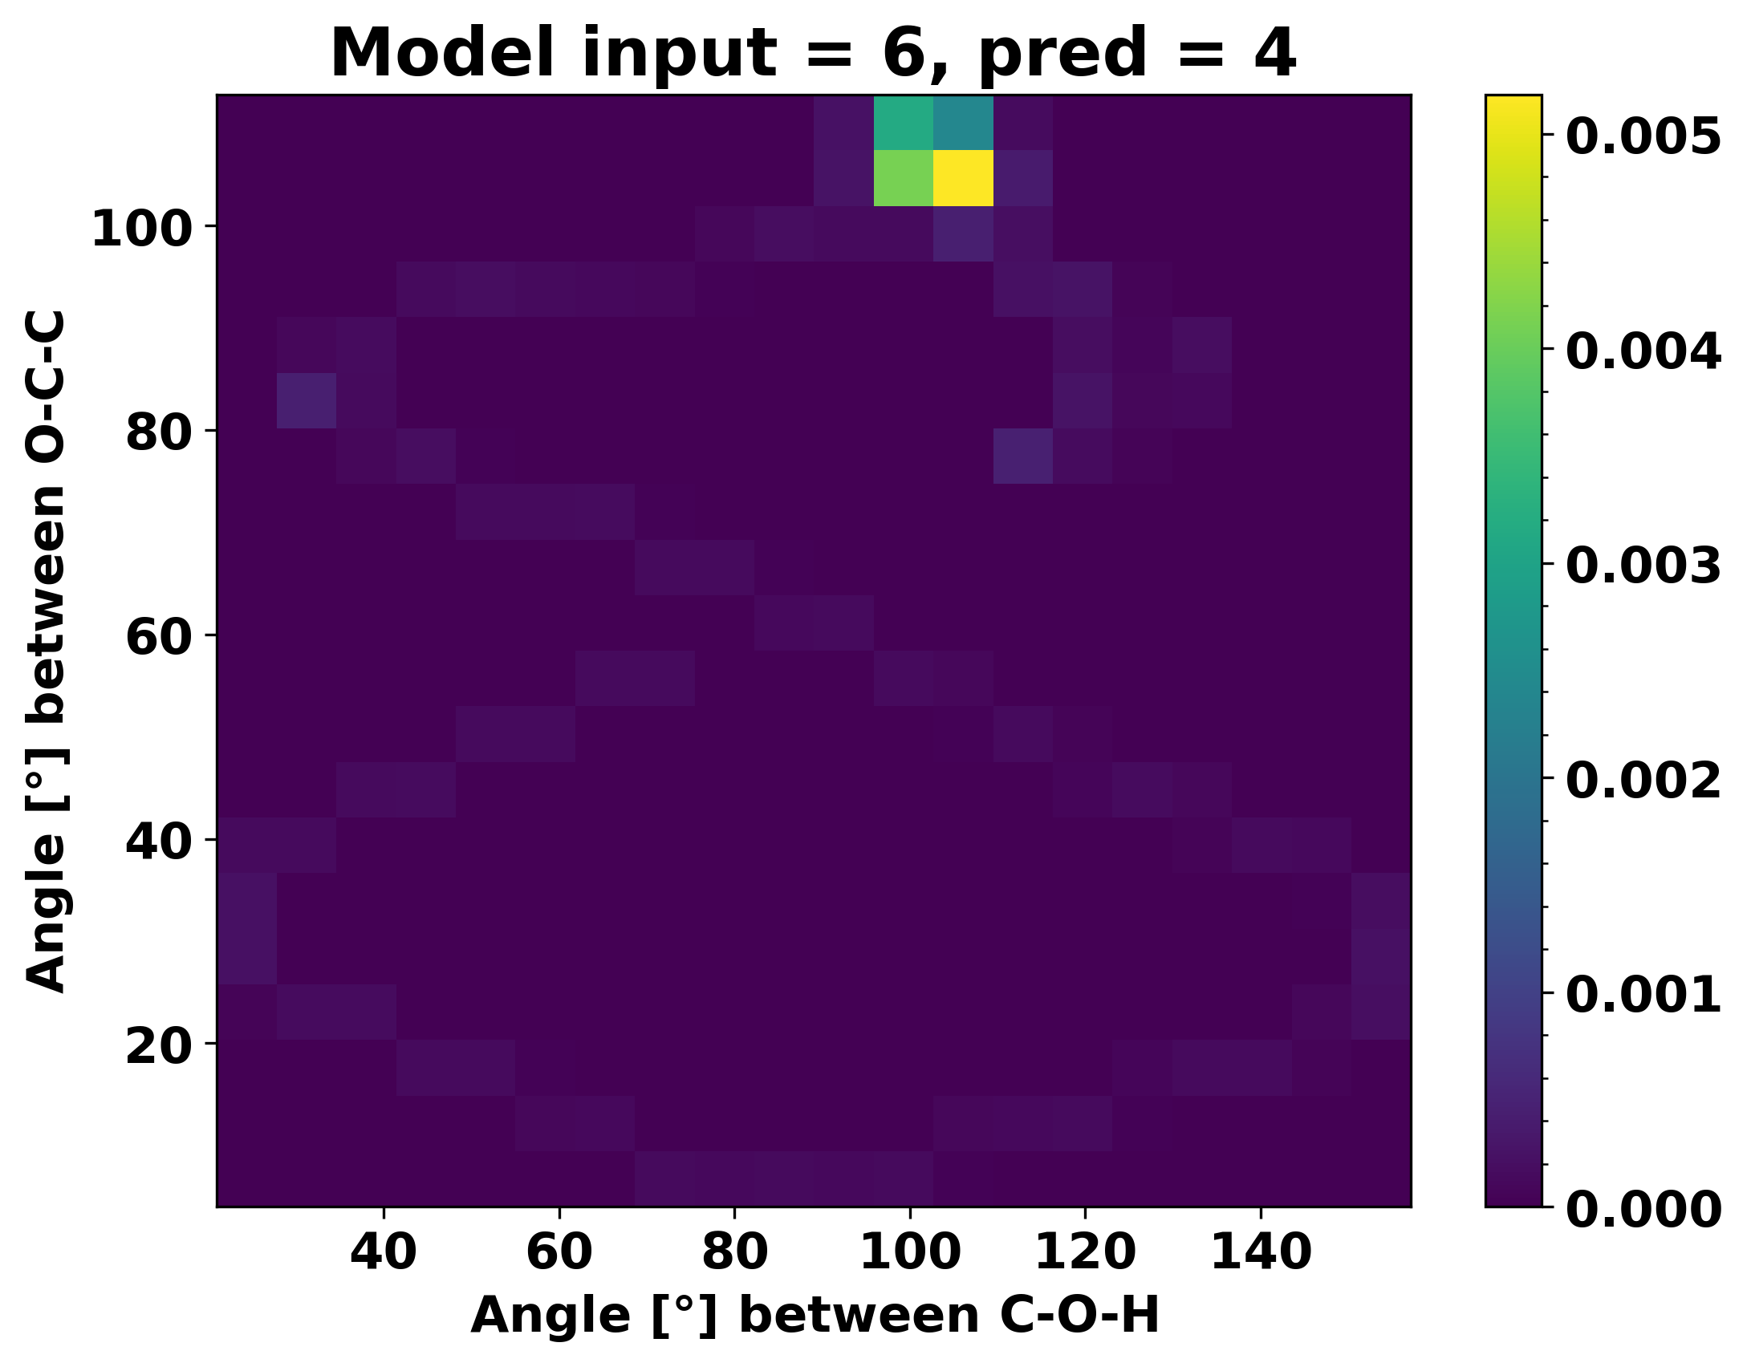
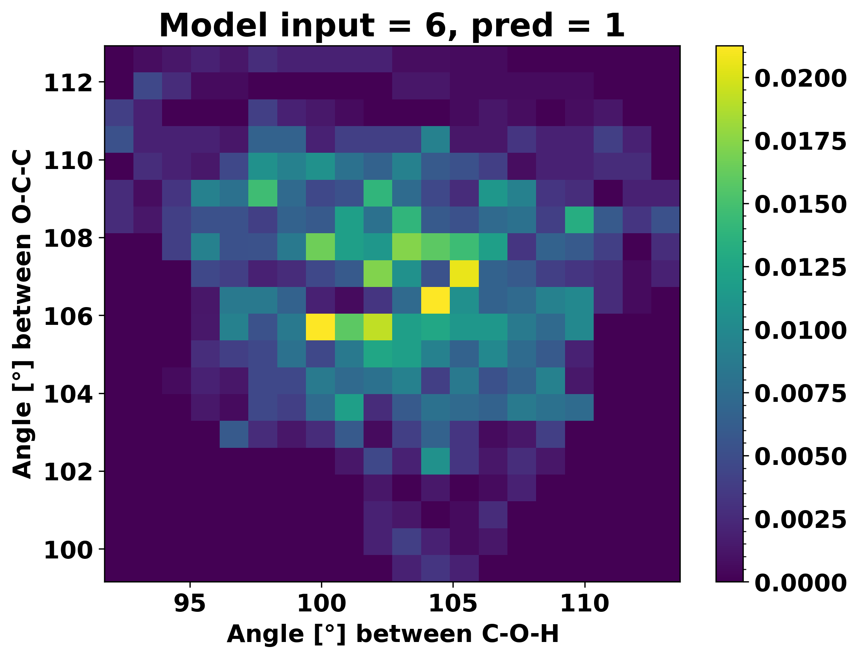
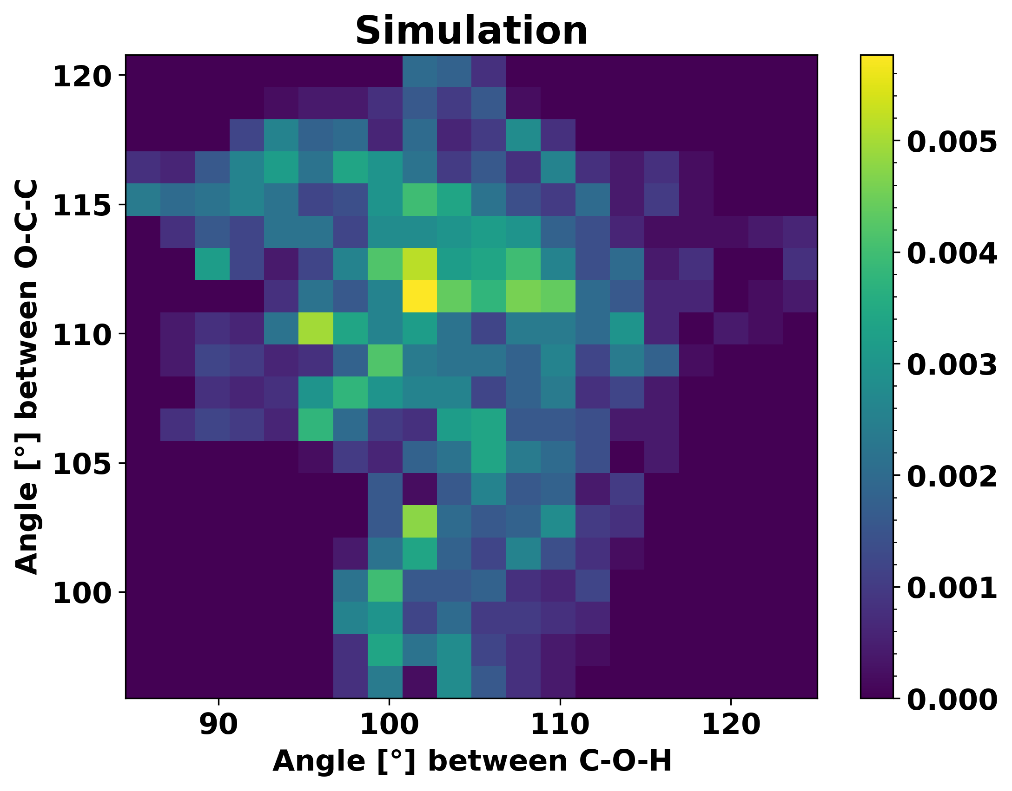
2D histogram

Slide 7
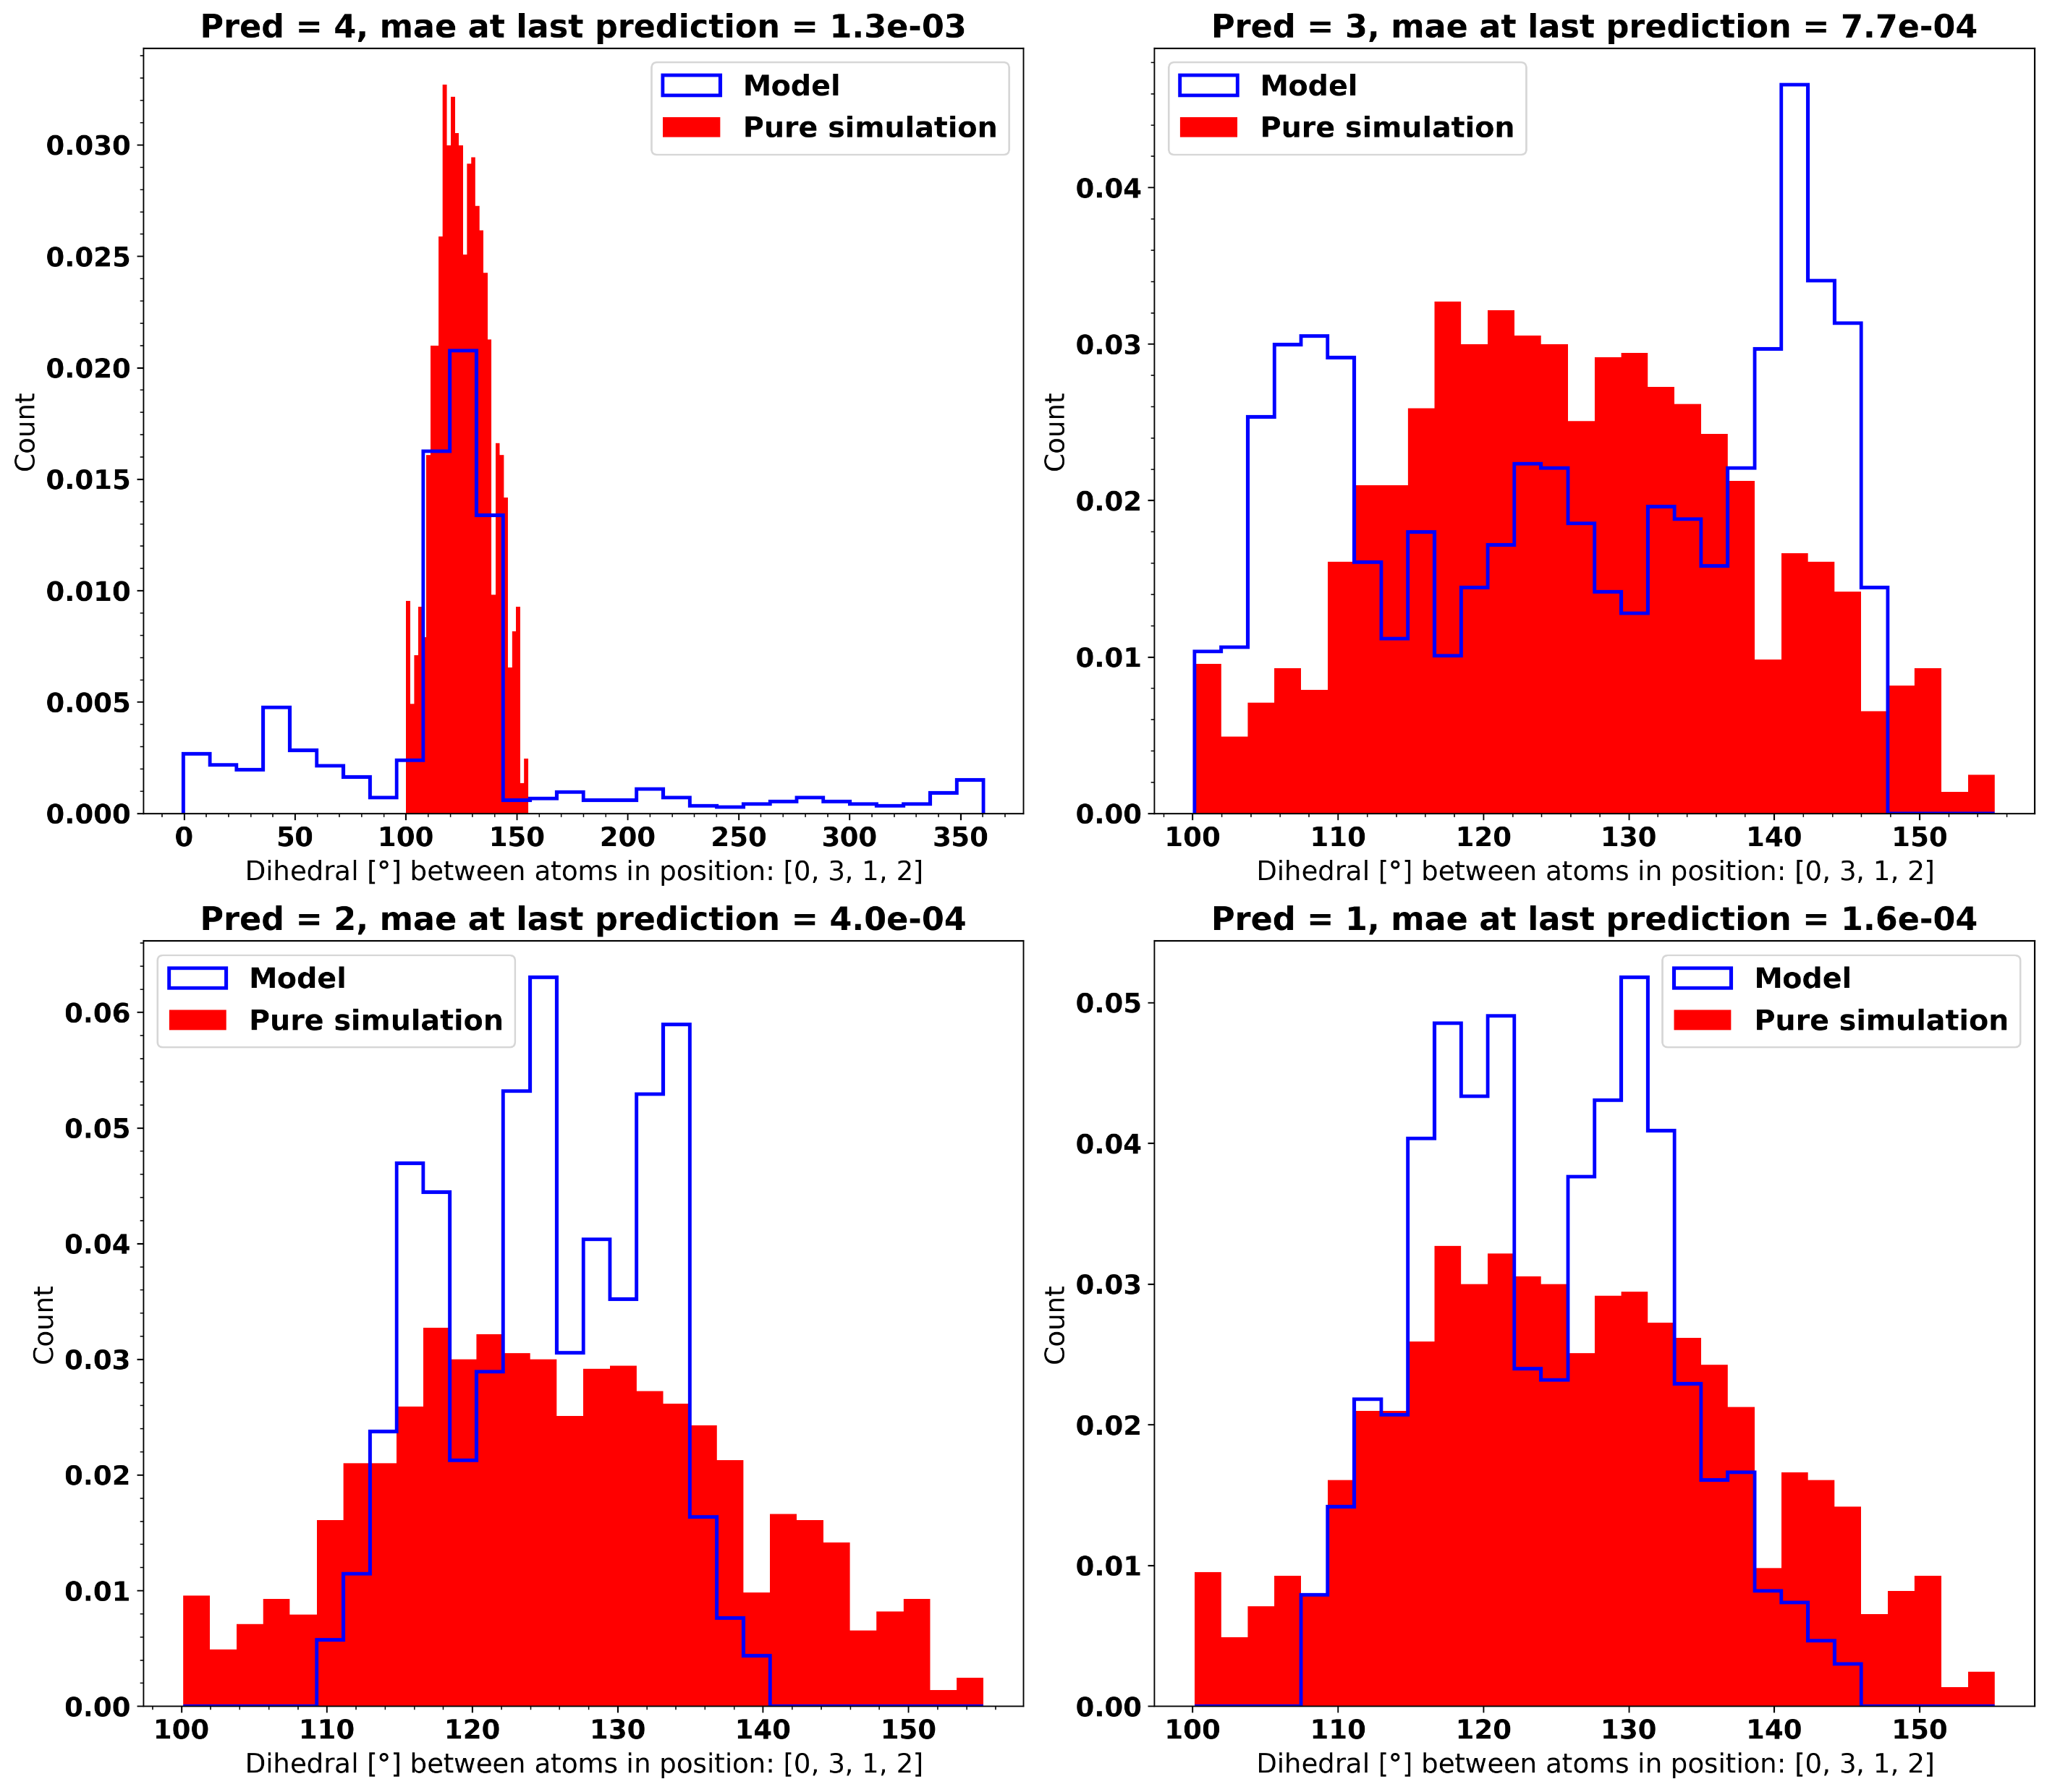
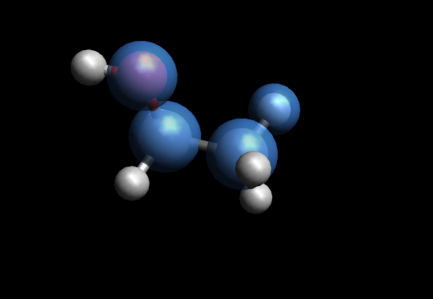
Distribution of Dihedral

Slide 8
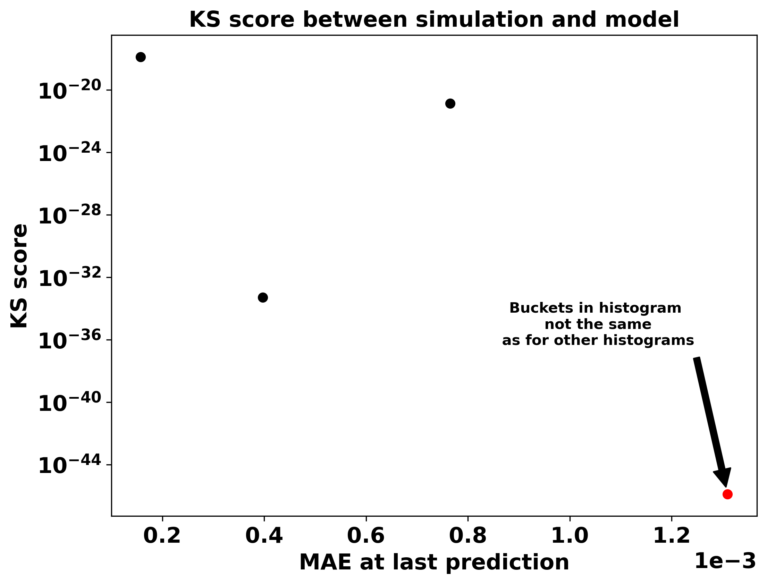
KS score of dihedral comparison

Slide 9
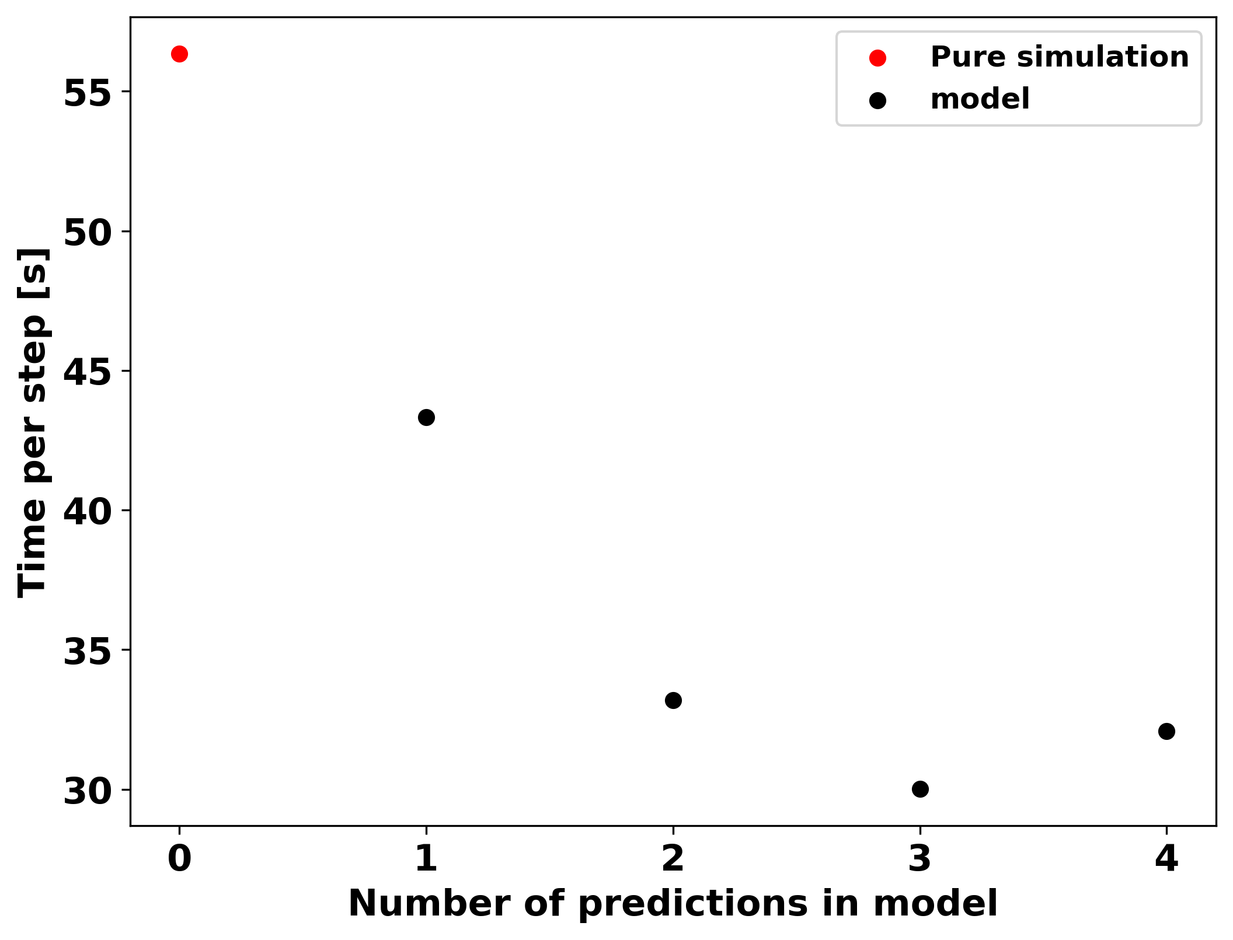
Time spent pr step for each simulation

Slide 10
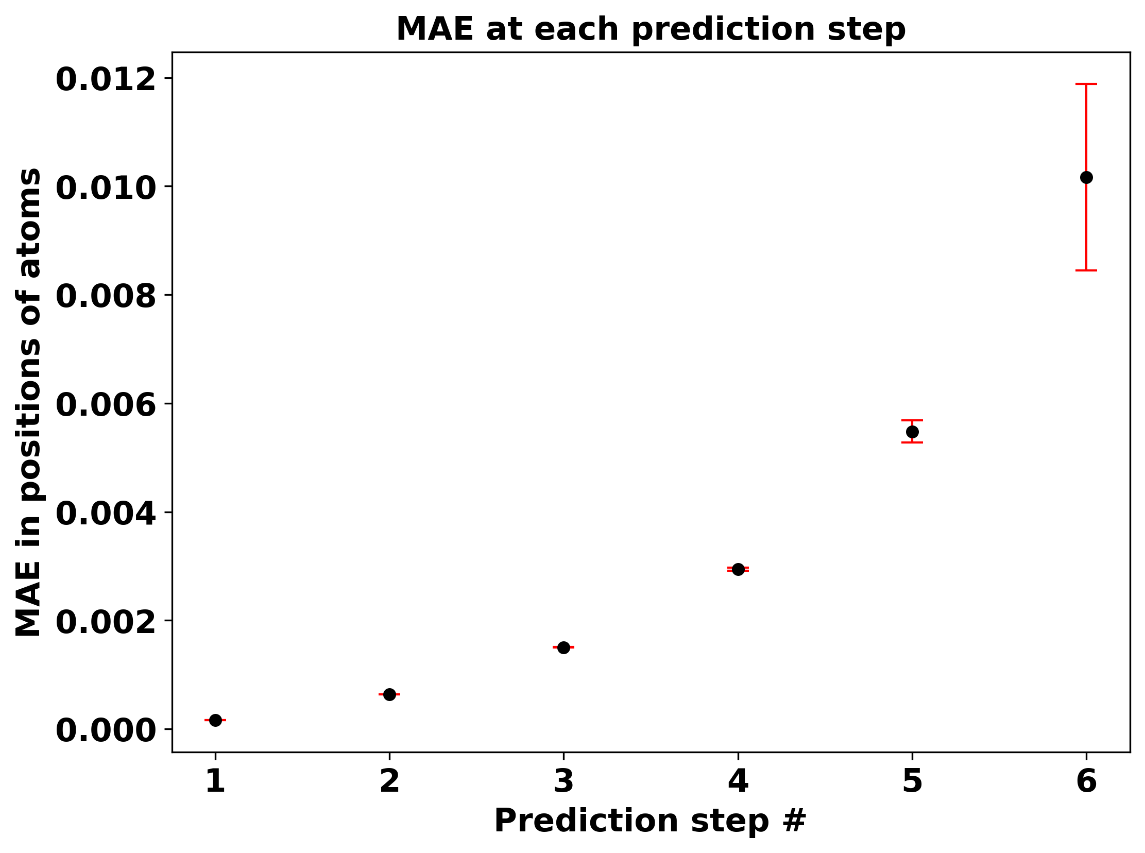
MAE of positions at predicted steps

Slide 11
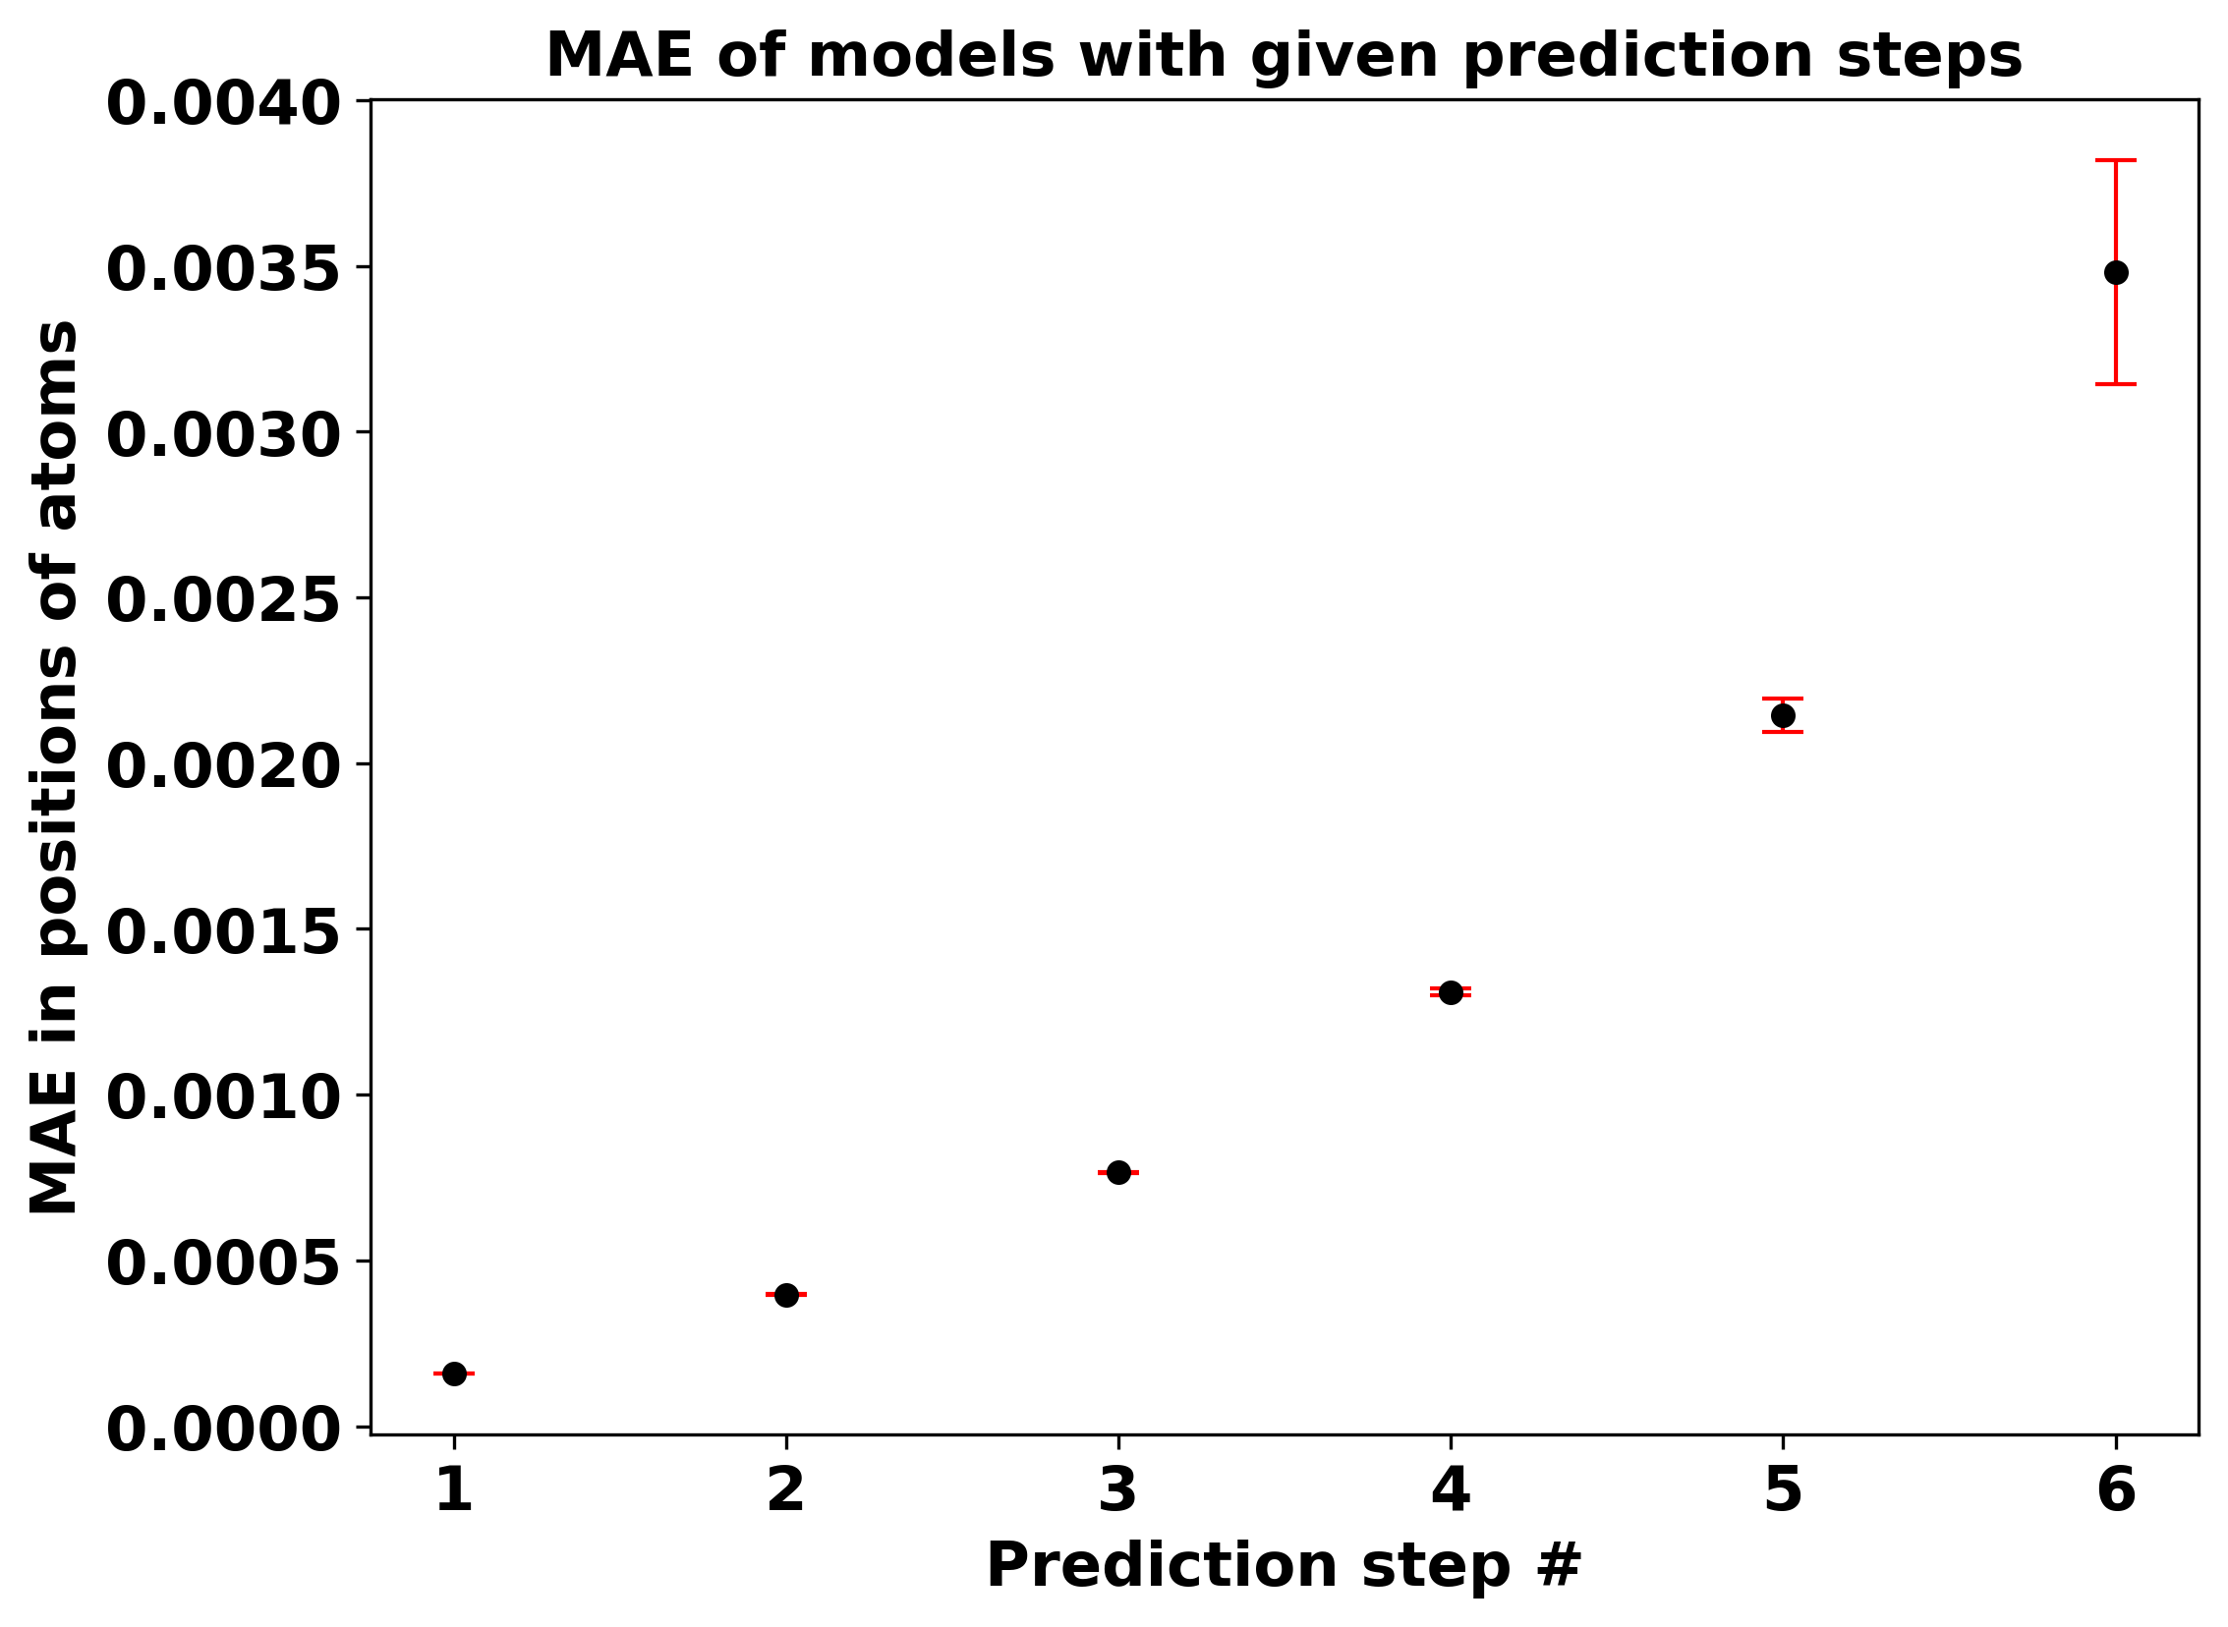
MAE of positions at predicted steps

Slide 12
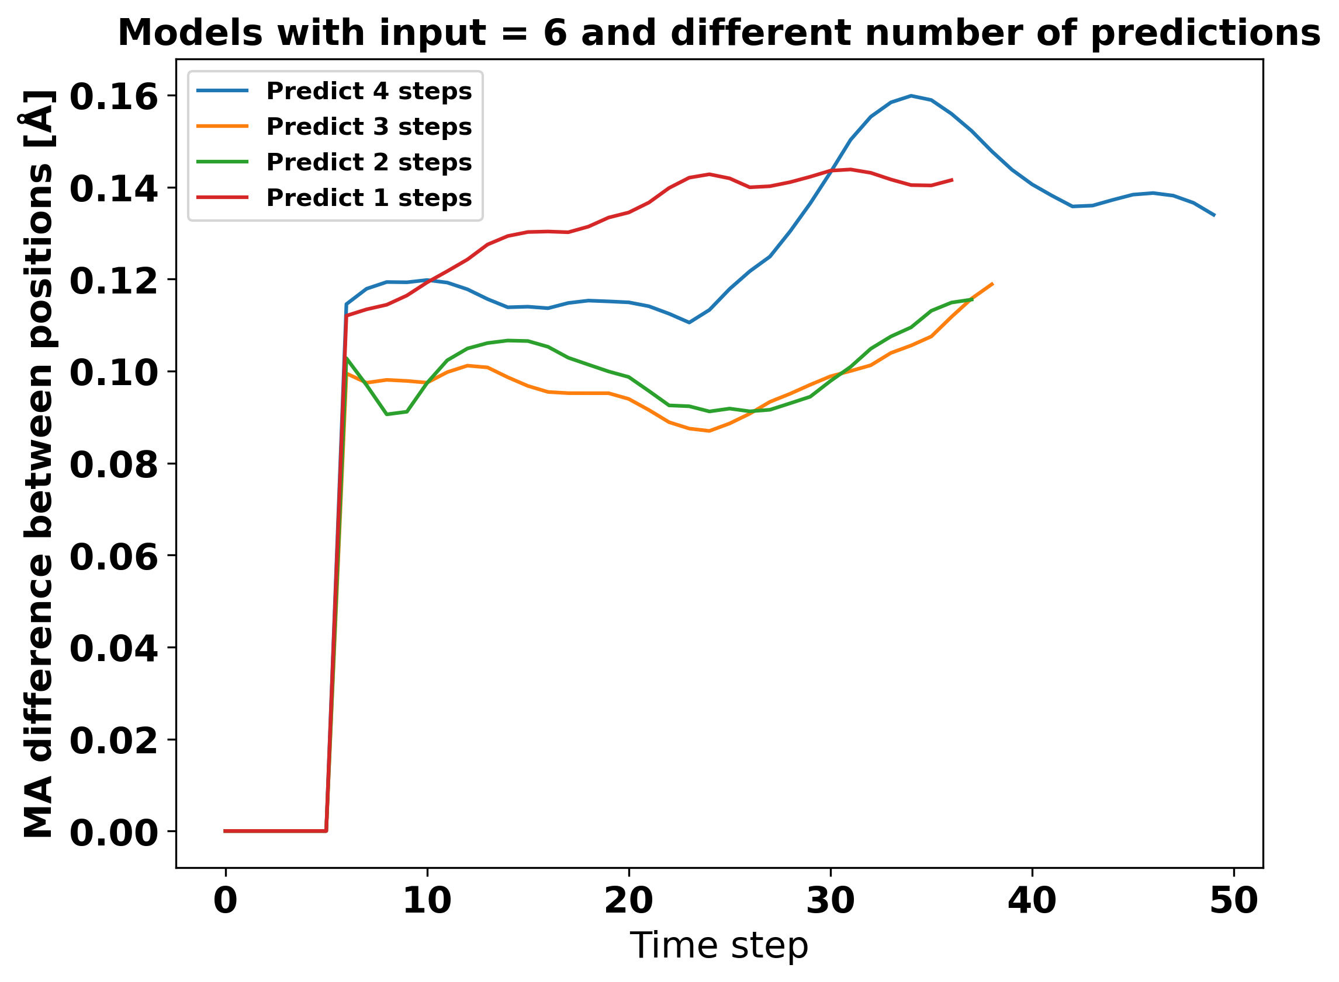

Slide 13
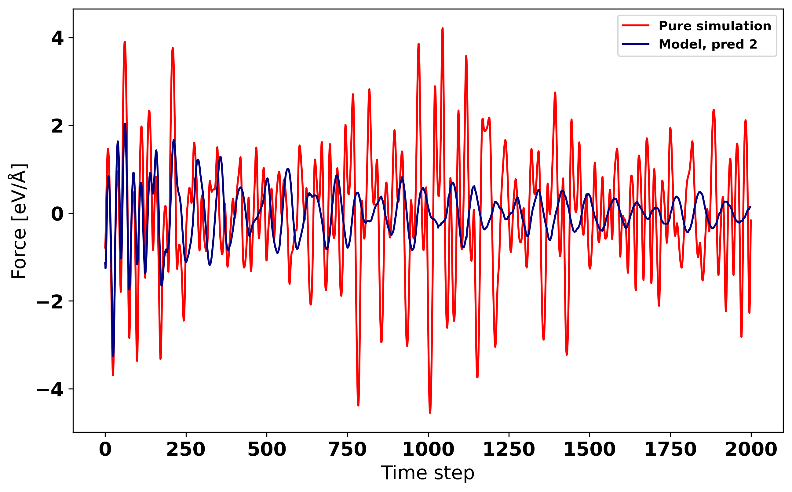
Force trajectory of simulation and model

